Slide 1

Implementation of Relational Calculus in SQL
Database Management System | Relational Model and Formal Query Languages
Course: Database Management System | Chapter: Relational Model and Formal Query Languages | Program: Bachelor of Engineering
DISCOVER · LEARN · EMPOWER
Notes:
Welcome everyone to today's lecture on the implementation of Relational Calculus in SQL. We are diving deep into how formal mathematical logic translates into practical database commands. This session is crucial for understanding the theoretical backbone of the SQL language you use daily. Remember, our motto at Chandigarh University is to Discover, Learn, and Empower through rigorous engineering education.

Slide 2
Course Outcomes
SLIDE 2 / 14
Course Outcome
CO | BT LEVEL | DESCRIPTION
CO1 | BT2 | Explain database architecture, relational model concepts and formal query language foundations including relational algebra and relational calculus.
CO2 | BT3 | Apply relational algebra, relational calculus and SQL constructs to formulate correct and efficient database queries.
CO3 | BT4 | Analyze functional dependencies and design normalized relational schemas up to 5NF ensuring lossless join and dependency preservation.
CO4 | BT4 | Analyze transaction schedules and concurrency control mechanisms to determine serializability, recoverability and correctness.
CO5 | BT5 | Evaluate storage structures, indexing strategies and query optimization techniques for performance, scalability and reliability.
Chandigarh University
2 / 14
Notes:
Today's lecture directly addresses two specific Course Outcomes. First, CO2 requires you to apply relational calculus and SQL to formulate efficient queries, which is our primary focus. Second, CO3 involves analyzing dependencies for normalization, which provides the structural context for why our queries must be precise. Mastering the link between calculus and SQL ensures you meet both these critical engineering competencies.

Slide 3
Learning Objectives
SLIDE 3 / 14
Learning Outcomes
1
Define the core components of Domain Relational Calculus and Tuple Relational Calculus.
2
Analyze how SQL SELECT statements map to formal relational calculus expressions.
3
Evaluate the equivalence between declarative calculus and imperative SQL query structures.
4
Construct complex SQL queries based on logical conditions derived from calculus.
5
Identify common pitfalls when translating theoretical calculus constraints into executable SQL code.
Chandigarh University
3 / 14
Notes:
By the end of this session, you will be able to define the core components of both Domain and Tuple Relational Calculus. You will analyze exactly how a standard SQL SELECT statement maps to these formal expressions. We will evaluate the equivalence between declarative logic and imperative SQL structures to ensure you understand the 'why' behind the syntax. Finally, you will learn to construct complex queries and identify common translation pitfalls.

Slide 4
Lecture
SLIDE 4 / 14
Relational Calculus Foundations
1
Relational Calculus is a non-procedural query language based on predicate logic.
2
It specifies what data to retrieve without defining the access path or algorithm.
3
Tuple Relational Calculus uses variables ranging over entire tuples of a relation.
4
Domain Relational Calculus uses variables ranging over individual attribute domains.
5
Both forms are equivalent in expressive power to Relational Algebra and SQL.
6
The syntax relies on logical operators like AND, OR, NOT, and quantifiers.
Chandigarh University
4 / 14
Notes:
Relational Calculus is fundamentally a non-procedural language rooted in predicate logic. It tells the database exactly what data you want, not how to find it. In Tuple Relational Calculus, variables represent entire rows, whereas in Domain Relational Calculus, they represent individual column values. Despite these differences, both forms are mathematically equivalent to Relational Algebra and the SQL language we use today.

Slide 5
Lecture
SLIDE 5 / 14
Tuple Relational Calculus Syntax
EXAMPLE
{ t | Student(t) ∧ t.grade > 9.0 } retrieves high-performing students.
• A TRC expression takes the form { t | P(t) } where t is a tuple variable.
• The predicate P(t) defines the conditions that the tuple t must satisfy.
• Variables are implicitly typed based on the relation they range over.
• Quantifiers include the universal (∀) and existential (∃) symbols for logic.
• The result is a set of tuples that make the predicate P(t) true.
Chandigarh University
5 / 14
Notes:
The syntax for Tuple Relational Calculus is { t | P(t) }, where t represents a tuple variable. The predicate P(t) acts as a filter, defining the specific conditions that the tuple must satisfy to be included in the result. Variables are implicitly typed based on the relation they range over, simplifying the query structure. For instance, { t | Student(t) ∧ t.grade > 9.0 } retrieves all tuples where the student's grade exceeds 9.0.

Slide 6
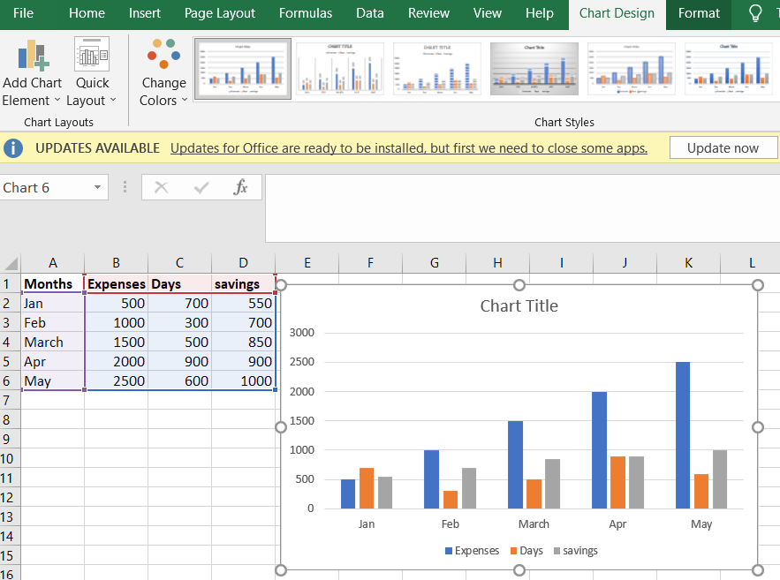
Lecture
SLIDE 6 / 14
Domain Relational Calculus Syntax
EXAMPLE
{ | Student(s_name, s_age) ∧ s_age > 20 }.
• A DRC expression takes the form { | P(x, y, z) } for specific attributes.
• Variables range over the domain of individual attributes rather than whole tuples.
• This form requires explicit specification of which attributes are being queried.
• It offers a more granular view of data retrieval compared to tuple variables.
• The predicate P defines the logical relationship between the domain variables.
Source: media.geeksforgeeks.org
Chandigarh University
6 / 14
Notes:
In Domain Relational Calculus, the expression { | P(x, y, z) } specifies variables for individual attributes. Unlike tuple variables, these range over the domain of specific columns, offering a more granular view of data retrieval. This form requires explicit specification of which attributes are being queried in the result set. For example, { | Student(s_name, s_age) ∧ s_age > 20 } retrieves names and ages for students over 20.

Slide 7
Lecture
SLIDE 7 / 14
Mapping TRC to SQL SELECT
1
The tuple variable t in TRC maps directly to the table alias in SQL.
2
The predicate P(t) translates to the WHERE clause conditions in SQL.
3
The attribute list in the result maps to the SELECT column list.
4
Existential quantifiers (∃) often correspond to subqueries or JOIN operations.
5
Universal quantifiers (∀) are frequently implemented using NOT EXISTS or NOT IN.
6
The logical structure remains identical despite the syntactic differences.
Chandigarh University
7 / 14
Notes:
The mapping from Tuple Relational Calculus to SQL is remarkably direct. The tuple variable t in TRC maps directly to the table alias in the SQL FROM clause. The predicate P(t) translates seamlessly into the WHERE clause conditions that filter the data. Existential quantifiers often correspond to subqueries or JOIN operations, while universal quantifiers are frequently implemented using NOT EXISTS or NOT IN clauses.

Slide 8
Lecture
SLIDE 8 / 14
Mapping DRC to SQL SELECT
EXAMPLE
{ | Student(name, age) } maps to SELECT name FROM Student.
• Domain variables map to specific column names in the SELECT and FROM clauses.
• The result tuple becomes the explicit list of columns in SELECT.
• The predicate P(x, y, z) defines the join and filter logic in the query.
• This mapping emphasizes the specific data types and domains of the attributes.
• It is particularly useful for queries involving specific attribute constraints.
Chandigarh University
8 / 14
Notes:
Domain Relational Calculus maps variables directly to specific column names in the SQL SELECT and FROM clauses. The result tuple becomes the explicit list of columns requested in the SELECT statement. The predicate P(x, y, z) defines the join and filter logic required to retrieve the data. This mapping is particularly useful for queries involving specific attribute constraints where column-level precision is needed.

Slide 9
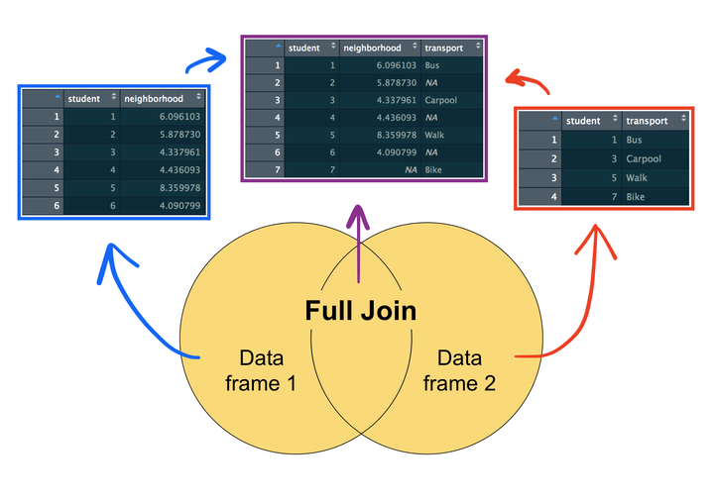
Worked Example
SLIDE 9 / 14
Existential Quantifier
PROBLEM
Find names of students who have taken course 'CS101'.
TRC EXPRESSION
{ t.name | Student(t) ∧ ∃s (Enrolled(s) ∧ s.sid = t.sid ∧ s.cid = 'CS101') }.
SQL EQUIVALENT
SELECT name FROM Student WHERE sid IN (SELECT sid FROM Enrolled WHERE cid = 'CS101').
• The existential quantifier ∃ translates to the IN operator or EXISTS clause.
• This logic ensures we only retrieve students with a matching enrollment record.
• The nested query in SQL mirrors the nested logical condition in TRC.
Source: www.rforecology.com
Chandigarh University
9 / 14
Notes:
Let's look at a worked example: finding names of students who have taken course 'CS101'. The TRC expression uses an existential quantifier to check for a matching enrollment record. In SQL, this translates to using the IN operator or an EXISTS clause within the WHERE condition. This logic ensures we only retrieve students who have a corresponding entry in the enrollment table for that specific course.

Slide 10
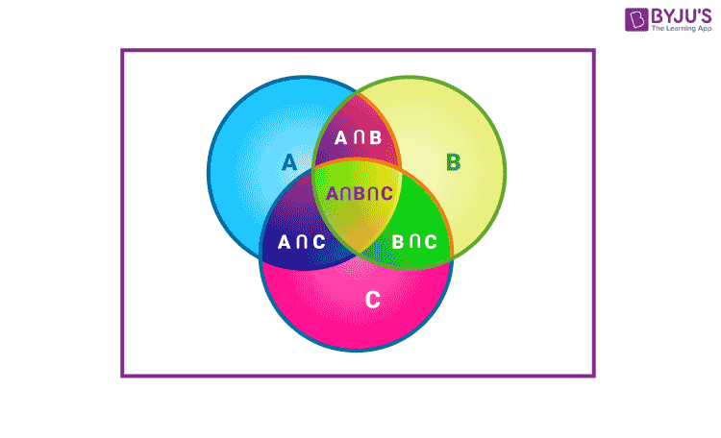
Worked Example
SLIDE 10 / 14
Universal Quantifier
PROBLEM
Find names of students who have taken ALL courses offered.
TRC EXPRESSION
{ t.name | Student(t) ∧ ∀c (Course(c) → ∃e (Enrolled(e) ∧ e.sid = t.sid ∧ e.cid = c.cid)) }.
SQL EQUIVALENT
SELECT name FROM Student WHERE NOT EXISTS (SELECT cid FROM Course WHERE NOT EXISTS (SELECT × FROM Enrolled WHERE sid = Student.sid AND cid = Course.cid)).
• Universal quantifiers (∀) are logically equivalent to NOT EXISTS (NOT P).
• This requires a double negation in SQL to express the 'for all' condition.
• The logic ensures no course exists that the student has not taken.
Source: cdn1.byjus.com
Chandigarh University
10 / 14
Notes:
Now consider a more complex problem: finding students who have taken ALL courses offered. The TRC expression uses a universal quantifier, which is logically equivalent to saying 'there does not exist a course the student has not taken'. In SQL, this requires a double negation using NOT EXISTS to express the 'for all' condition. The logic ensures that for every course in the database, a matching enrollment record exists for that student.

Slide 11
Lecture
SLIDE 11 / 14
Common Pitfalls in Translation
1
Confusing the scope of variables in nested quantifiers leads to incorrect results.
2
Misinterpreting the implication operator (→) in universal quantifier translations.
3
Forgetting to handle NULL values which behave differently in logic vs SQL.
4
Assuming SQL execution order matches the logical order of calculus expressions.
5
Overlooking the difference between free variables and bound variables in queries.
6
Incorrectly mapping logical OR to SQL OR without considering set union.
Chandigarh University
11 / 14
Notes:
There are several common pitfalls when translating calculus to SQL. Confusing the scope of variables in nested quantifiers often leads to incorrect results. Students frequently misinterpret the implication operator in universal quantifier translations, leading to logic errors. Additionally, forgetting to handle NULL values is critical, as they behave differently in formal logic compared to standard SQL execution. Always verify that your free variables are correctly bound before executing the query.

Slide 12
Lecture
SLIDE 12 / 14
Equivalence of Query Languages
1
Relational Algebra, Tuple Calculus, Domain Calculus, and SQL are relationally complete.
2
Any query expressible in one formalism can be expressed in the others.
3
The difference lies in the syntax and the level of procedural detail.
4
SQL adds procedural extensions like UPDATE and DELETE to the declarative core.
5
The optimizer in DBMS translates declarative calculus into efficient execution plans.
6
Understanding calculus helps in writing more efficient and correct SQL queries.
Chandigarh University
12 / 14
Notes:
Relational Algebra, Tuple Calculus, Domain Calculus, and SQL are all relationally complete. This means any query expressible in one formalism can be expressed in the others. The primary difference lies in the syntax and the level of procedural detail required. While SQL adds procedural extensions like UPDATE and DELETE, the core remains declarative. Understanding the underlying calculus helps you write more efficient and correct SQL queries by leveraging the optimizer's capabilities.

Slide 13
Lecture
SLIDE 13 / 14
Key Takeaways
1
Relational Calculus defines queries using predicate logic without specifying access paths.
2
Tuple variables range over rows, while domain variables range over individual attributes.
3
SQL SELECT statements are direct implementations of relational calculus expressions.
4
Universal quantifiers require double negation (NOT EXISTS) in standard SQL.
5
Mastering calculus improves your ability to write complex and optimized database queries.
Chandigarh University
13 / 14
Notes:
To summarize, Relational Calculus defines queries using predicate logic without specifying access paths. Tuple variables range over rows, while domain variables range over individual attributes. SQL SELECT statements are direct implementations of these calculus expressions. Remember that universal quantifiers require double negation using NOT EXISTS in standard SQL. Mastering this calculus will significantly improve your ability to write complex and optimized database queries.

Slide 14
Lecture
SLIDE 14 / 14
References
1
Fundamentals of Database Systems — Ramez Elmasri & Shamkant B. Navathe
2
Database System Concepts — Silberschatz, Korth & Sudarshan
3
Database Management Systems — Raghu Ramakrishnan & Johannes Gehrke
4
Oracle/MySQL Documentation — Oracle
Chandigarh University
14 / 14
Notes:
For further reading, I recommend the standard texts by Elmasri & Navathe and Silberschatz et al. These books provide comprehensive coverage of relational theory and SQL implementation. The text by Ramakrishnan & Gehrke offers excellent insights into database management systems. Finally, consult the official Oracle and MySQL documentation for specific syntax details and best practices.

